Slide 1

Biologically plausible deep learning But how far can we go with shallow networks?
Bernd Illing, Wulfram Gerstner, Johanni Brea
Presentation by
Mohammad Amin Banayeean Zade

Slide 2

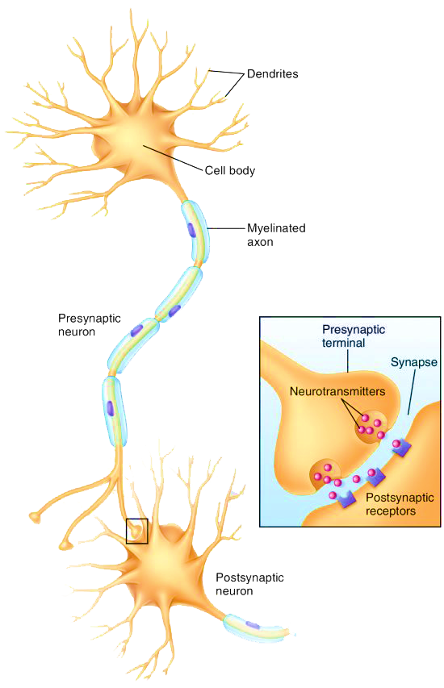
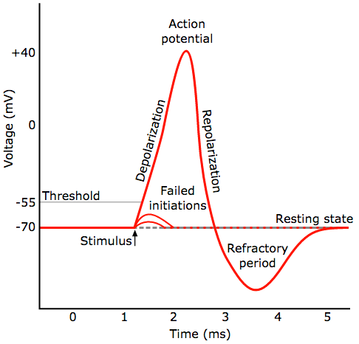
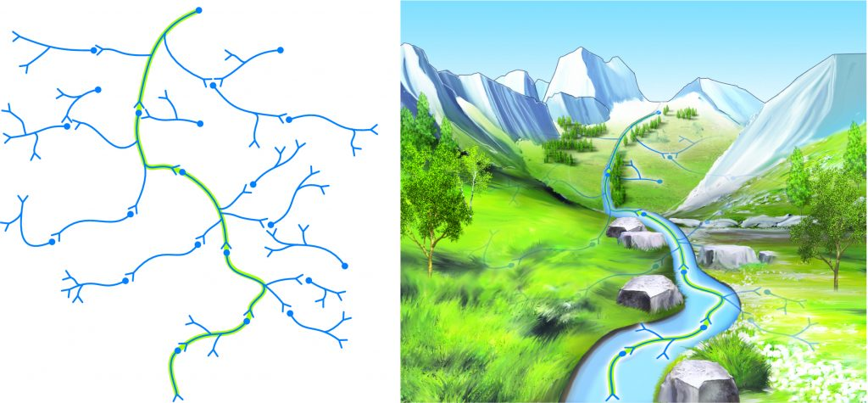
Introduction
https://www.researchgate.net/figure/A-general-model-of-a-deep-neural-network-It-consists-of-an-input-layer-some-here-two_fig1_308414212
https://www.kurzweilai.net/ibm-scientists-emulate-neurons-with-phase-change-technology
https://www.guru99.com/backpropogation-neural-network.html
Notes:
Deep neural networks – error back propagation
Synapses – Hebb learning rule – STDP –Neuron pathways – backprop approximation - feedback alignment -
Spiky neurons - LIF model
Unfeasible backprop algorithm

Slide 3
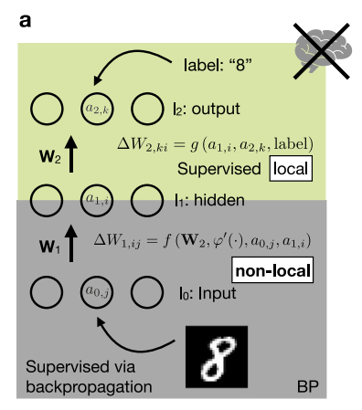
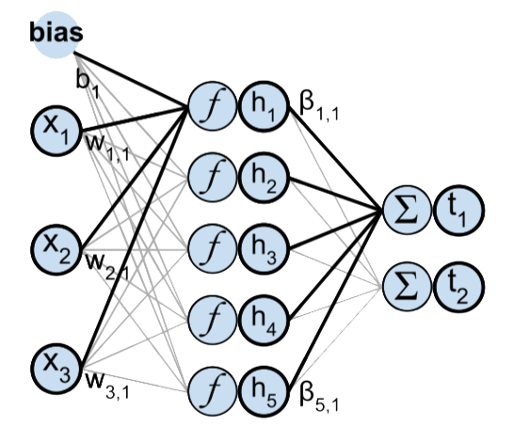
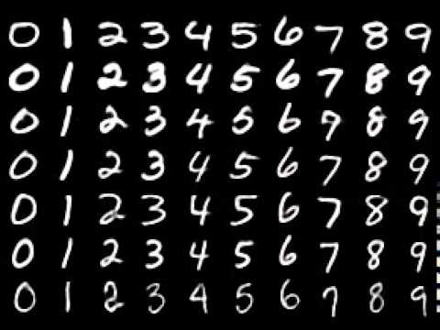
CONTENTS OF THIS TEMPLATE
Supervised Learning
https://github.com/cazala/mnist
https://towardsdatascience.com/ml-for-ts-3-extreme-learning-machines-3fcf5991e390
Notes:
Why shallow Network
Why mnist dataset: easy to learn – doesn’t need cnn or data augmentation – is used to benchmark back prop

Slide 4
Alternatives to Supervised Training
fix weights in the first layer(s) at random values , as proposed by general approximation theory
The other alternative is unsupervised training in the first layer(s)
In both cases, only the weights of a readout layer are learned with supervised training
Random Weights
Unsupervised
https://towardsdatascience.com/ml-for-ts-3-extreme-learning-machines-3fcf5991e390
RP
ICA
RG
PCA
SC
Notes:
Alternatives to ST
Readout layer can be trained by local rules

Slide 5
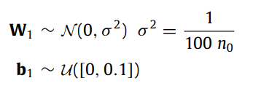
Random Projections
Random Weights
Unsupervised
https://towardsdatascience.com/ml-for-ts-3-extreme-learning-machines-3fcf5991e390
RP
ICA
RG
PCA
SC
Notes:
Gaussian prior on first layer

Slide 6
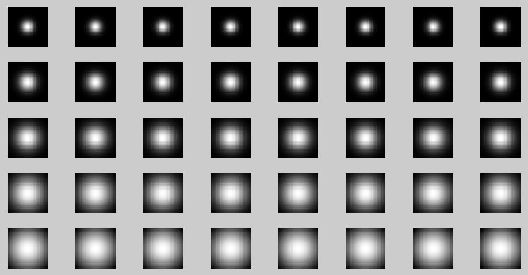
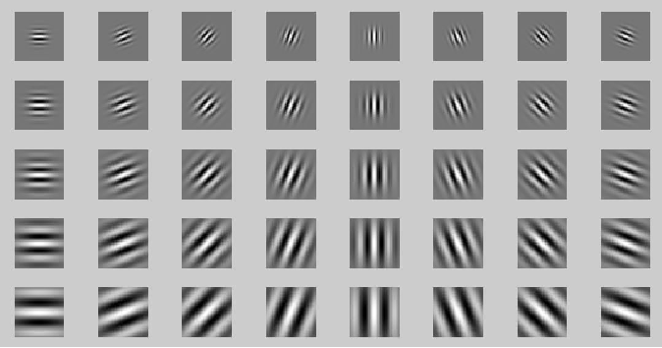
Random Gabor Filters
https://www.semanticscholar.org/paper/Local-binary-pattern%3A-An-improved-LBP-to-extract-to-Kumar-Kumar/f05b226b35f6871d9b3cda9691dba67d238d683d
Random Weights
Unsupervised
RP
ICA
RG
PCA
SC

Slide 7
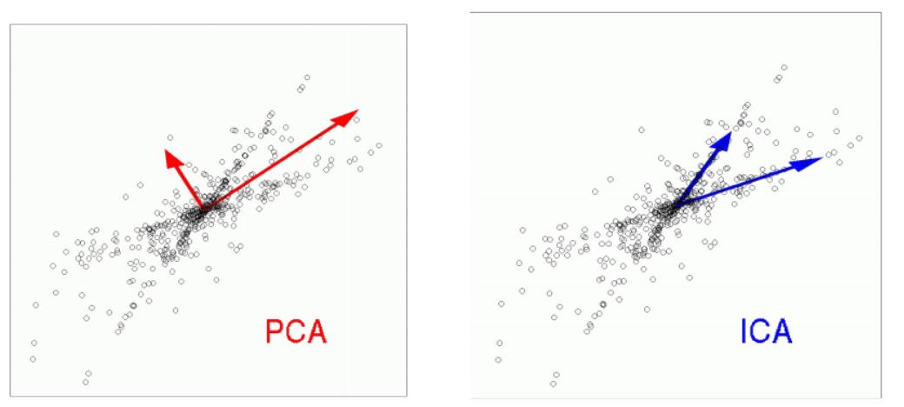
Random Gabor Filters
http://compneurosci.com/wiki/images/4/42/Intro_to_PCA_and_ICA.pdf
Random Weights
Unsupervised
RP
ICA
RG
PCA
SC
Notes:
PCA vs ICA
 PCA removes correlations, but not higher order dependence  ICA removes correlations and higher order dependence  PCA: some components are more important than others (recall eigenvalues)  ICA: all components are equally important  PCA: vectors are orthogonal (recall eigenvectors of covariance matrix)  ICA vectors are not orthogonal

Slide 8
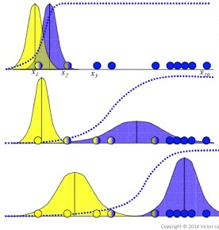
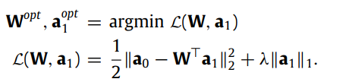
Sparse Coding
Random Weights
Unsupervised
ICA
https://www.youtube.com/watch?v=XLKoTqGao7U
RP
RG
PCA
SC
Notes:
Sparse Coding

Slide 9
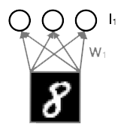
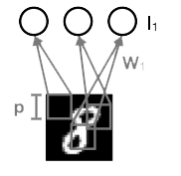
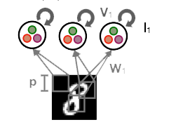
localized receptive fields
Localized
Random Weights
Unsupervised
RP
ICA
RG
PCA
SC
Notes:
Localized – CNN
Inhibitory weight

Slide 10
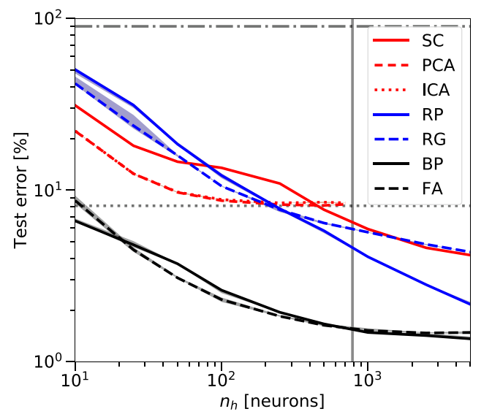
Results

Slide 11
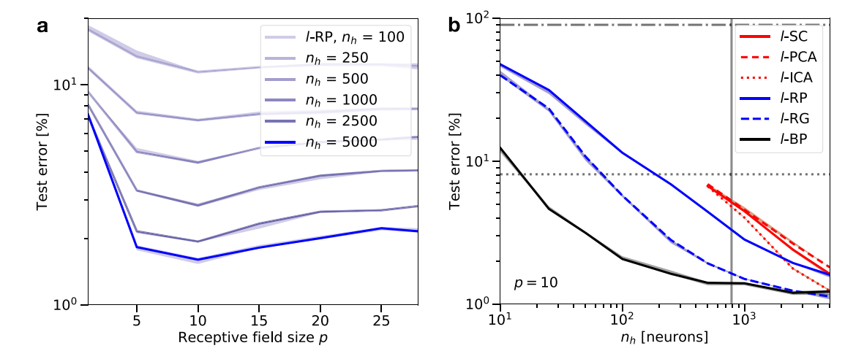
Results

Slide 12
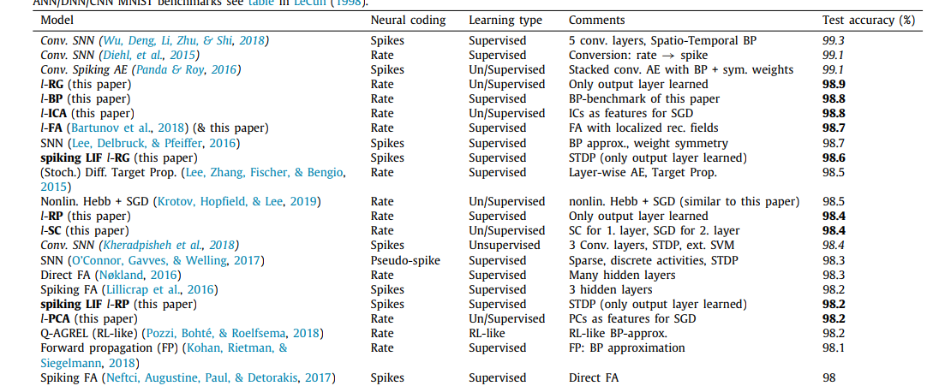
Results

Slide 13
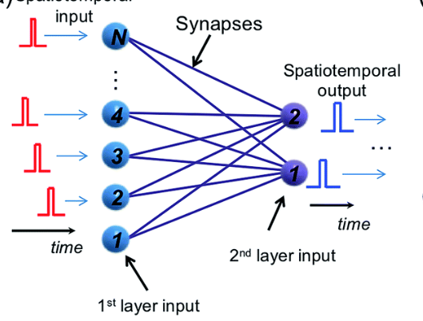
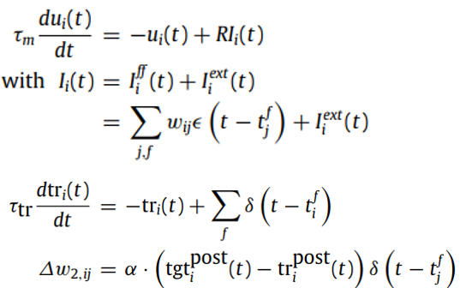
Spiking localized random projections
https://pubs.rsc.org/image/article/2019/fd/c8fd00097b/c8fd00097b-f8_hi-res.gif

Slide 14
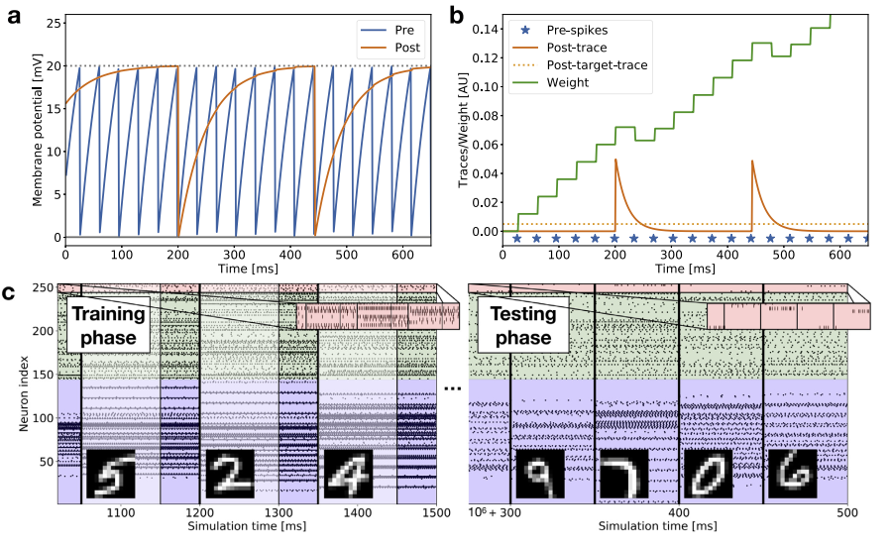
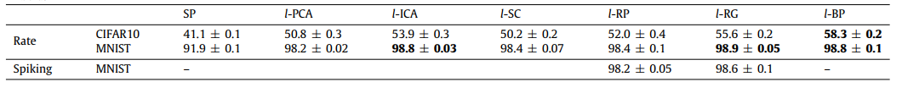
Results

Slide 15
Thanks any questions?

